Slide 1
Occurance of metals
CHAPTER 03:Part 3
Notes:
Hi students. In this chapter, we are going to learn all about reflection and refraction of light.

Slide 2
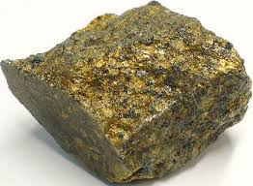
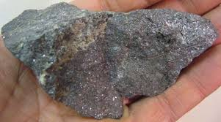
Occurrence Of Metals
Notes:
Occurence Of Metals:
Most metal are reactive therefore found in form of compound..
Compound of CARBONATE,SULPHIDE,CHLORIDE
Cu , Ag and Au being less reactive can be formed in native state (freestate)
All metal above Cu are found in form of compounds
MINERALS AND ORES
The natural material in which metal exist is called MINERAL Those mineral from which metal can extracted are called OREs

Slide 3
Extraction Of Metal
The process of obtaining metal from ore is called extraction of metal
The various process involved in the extraction of metal is called METTALURGY
The three major steps involved in the purification of metal are
a)Concentration of Ore
b)Conversion of concentrated ore into metal
c)Refining of impure metal
Notes:
Extraction Of Metal:
The process of obtaining metal from ore is called extraction of metal
The various process involved in the extraction of metal is called METTALURGY
The three major steps involved in the purification of metal are
a)Concentration of Ore
b)Conversion of concentrated ore into metal
c)Refining of impure metal

Slide 4
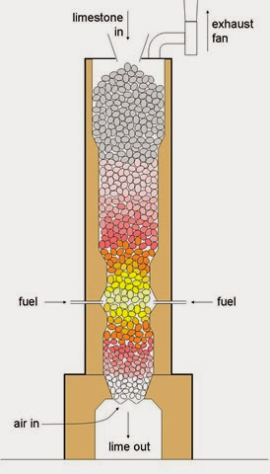
Extraction Of Moderatively Reactive MEtals
_{(Calcination) ZnO}
_{CO₂}
ZnCO₃
+
A sulphide ore ->oxide (roasting)
The metal oxide obtained are converted to free metal by reduction with C,Al,Na,Ca
_{(ROASTING) ZnO}
_{SO₂}
ZnS
+
O₂
+
Notes:
Extraction of moderately reactive metal
The extraction of metal is harder with carbonates and sulphides Therefore all ores are converted into oxide by Calcination or by roasting
A carbonate ore -> oxide (Calcination)
CALCINATION :- process in which carbonate ore is heated in the ABSENCE of oxygen to get metal oxide
Ex- ZnCO₃ ->(Calcination) ZnO + CO₂
A sulphide ore ->oxide (roasting)
Roasting :- process of heating sulphide ore in PRESENCE of oxygen to get metal oxide
ZnS + O₂ -> (ROASTING) ZnO+ SO₂
The metal oxide obtained are converted to free metal by reduction with C,Al,Na,Ca

Slide 5
Thermite Reaction
the reduction of metal oxide to form metal by using Al as reducing agent
This process is called Thermite welding OR aluminothermy
Fe₂O₃
+
Al
_{Fe (molten)}
+
_{Al₂O₃}
+
heat
Notes:
In this slide we will learn all about the thermite reaction
Thermite Rxn:- the reduction of metal oxide to form metal by using Al as reducing agent
Fe₂O₃ + Al -> Fe (molten) + Al₂O₃ + heat
This process is called Thermite welding OR aluminothermy
The reaction is initiated by the heat from burning magnesium ribbon which is placed in the iron oxide/aluminum mixture, this is the fuse!

Slide 6
Extraction Of Less Reactive Metals
The reaction is initiated by the heat from burning magnesium ribbon which is placed in the iron oxide/aluminum mixture, this is the fuse
Extraction of Low Reactivity Metals. Metals like copper, mercury, silver and gold are less reactive. Metals at the bottom of the reactivity series can be obtained by heating their compounds. For example, when cinnabar (HgS) is heated in a furnace, it is reduced to metallic mercury.
Notes:
C) Extraction Of Less Reactive Metal:
Are extracted just by reduction of their oxide by heating
Or Just By Heating In Air
Extraction of Low Reactivity Metals. Metals like copper, mercury, silver and gold are less reactive. Metals at the bottom of the reactivity series can be obtained by heating their compounds. For example, when cinnabar (HgS) is heated in a furnace, it is reduced to metallic mercury.

Slide 7
Refining Of Metals
The process of refining of impure metal is called refining of metal .
Most common one is Electrolytic refining
Electrolytic refining :- refining by electrolysis
A thick block of impure metal is made anode
a thin strip of pure metal is mate cathode
A water soluble salt of metal is taken as electrolyte .
Notes:
Refining of Metal:
The process of refining of impure metal is called refining of metal .
Most common one is Electrolytic refining
Electrolytic refining :- refining by electrolysis
A thick block of impure metal is made anode
a thin strip of pure metal is mate cathode
A water soluble salt of metal is taken as electrolyte .

